Slide 1
EDA On Brazil Housing
By
Amrutha Padmakumar

Slide 2
Problem Statement
Rio De Janeiro and Sao Paulo are among the most expensive cities to live in Brazil. Many people from these cities are considering relocating to a different city to live and work remotely.
Castro Brazila Inc a top real estate management firm with a nationwide presence in Brazil , wishes to help people choose an alternate city to relocate to. Help the firm figure out suitable cities for relocation for bachelors, for mid-sized families and for large families.

Slide 3
Understanding Data:
There are 10692 rows × 13 columns in the housing data.
The columns are City, Area, Rooms, Bathrooms, Parking space, Floor, Pets, Furniture, HOA, Rent Amount, Property Tax, Fire Insurance, Total.
Categorical columns: City, Rooms, Bathrooms, Parking space, Floor, Pets, Furniture
Continuous columns: Area, HOA(R$), Rent Amount(R$), Property Tax(R$), Fire Insurance(R$),Total(R$)
Columns that are considered for analysis are :
City, Area, Rooms, Bathrooms, Parking space, Pets, Furniture, Rent Amount, Property Tax, Total.

Slide 4
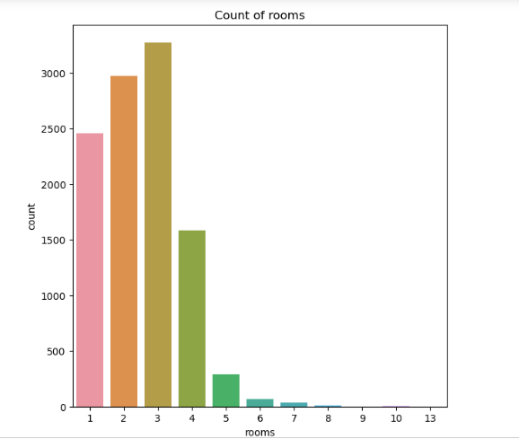
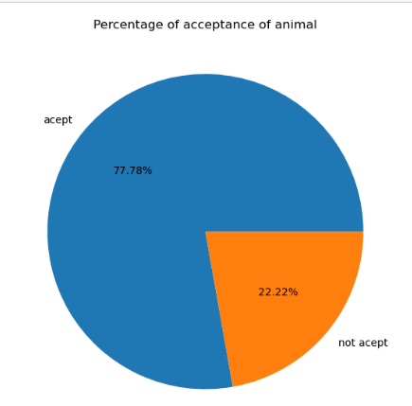
Univariate Analysis on Categorical column
Distribution of rooms
Distribution of acceptance of animals
Interpretation:
By observing above graph we can conclude that most of the houses available for rent are three roomed.
By observing above pie chart we conclude that most of the properties available for rent accept animals.

Slide 5
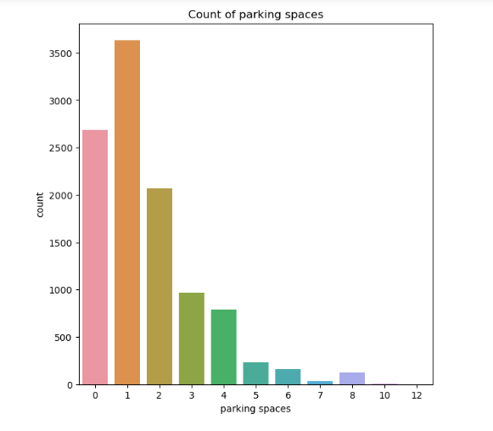
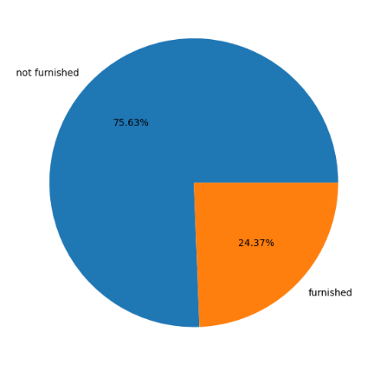
Distribution of parking spaces
Distribution of furnished rooms
Percentage of furnished houses
Interpretation:
By observing above graph we conclude that most of the houses available for rent have only 1 parking space.
By observing above pie chart we conclude that most of the properties available for rent are Not furnished.

Slide 6
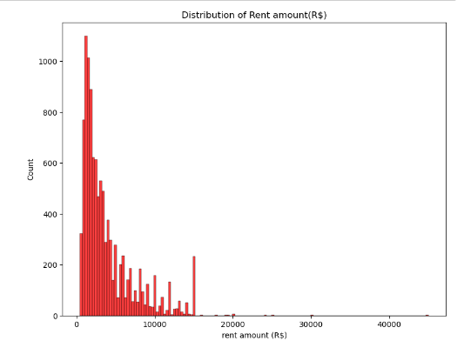
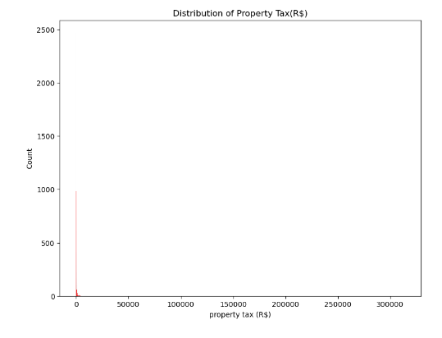
Univariate Analysis on Continuous column
Distribution of rent amount
Distribution of property tax
Both the graphs shows outlier in the data .so we need to perform outlier treatment.

Slide 7
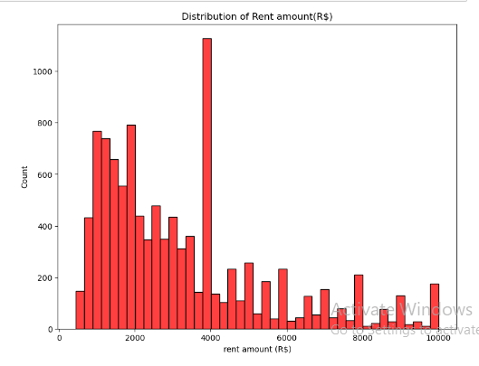
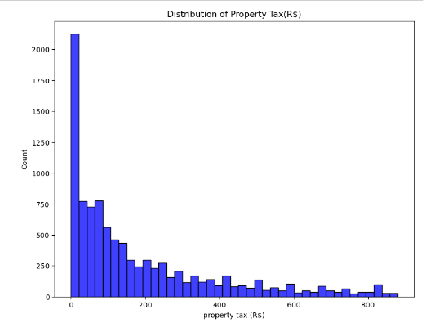
Interpretation:
By observing above graph we can see that the maximum rent is R$.4000
By observing above graph we conclude that most of the houses available for rent have 0 property tax

Slide 8
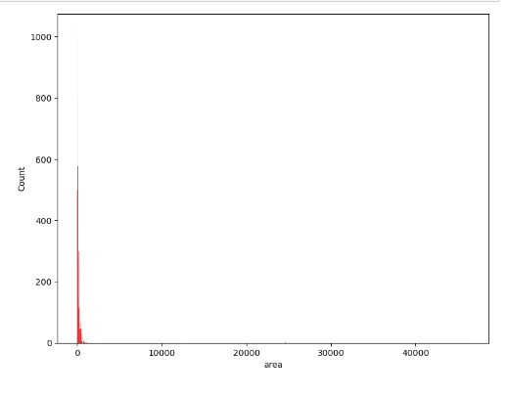
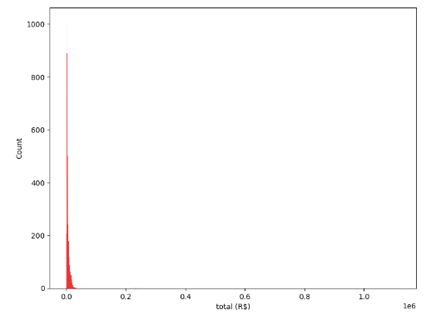
Distribution of area
Distribution of total(R$)
Both the graphs shows outlier in the data .so we need to perform outlier treatment.

Slide 9
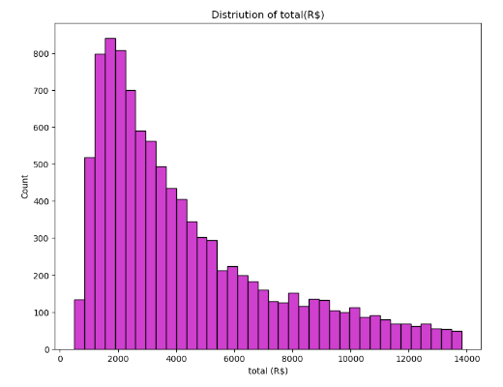
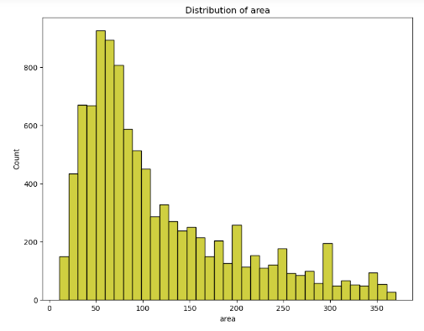
Interpretation:
By observing the graph we can conclude that 2000 is the common total cost value for the properties.
By observing above graph we conclude that most of the properties for rent have an area of 50 to 70 square meters.

Slide 10
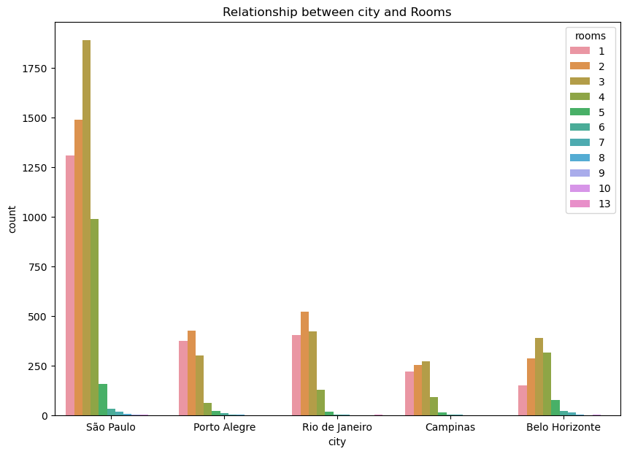
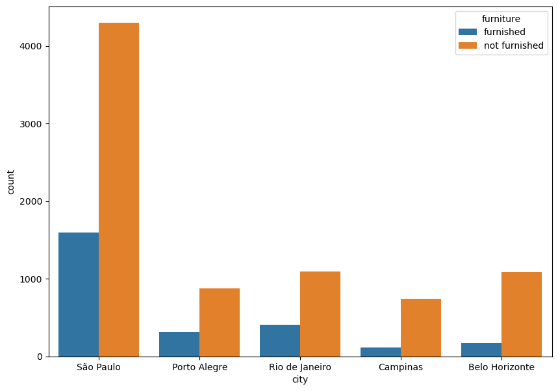
Bivariate Analysis
Relationship between cities and room
Relationship between city and furniture
Interpretation:
From above graph we can conclude that Porto Alegre has more number of 1 or 2 rooms and campinas and Belo Horizonte have houses more than 2 rooms.
Interpretation:
Belo Horizonte city donot have much furnished houses.
Furnished rooms are more available in Porto Alegre city

Slide 11
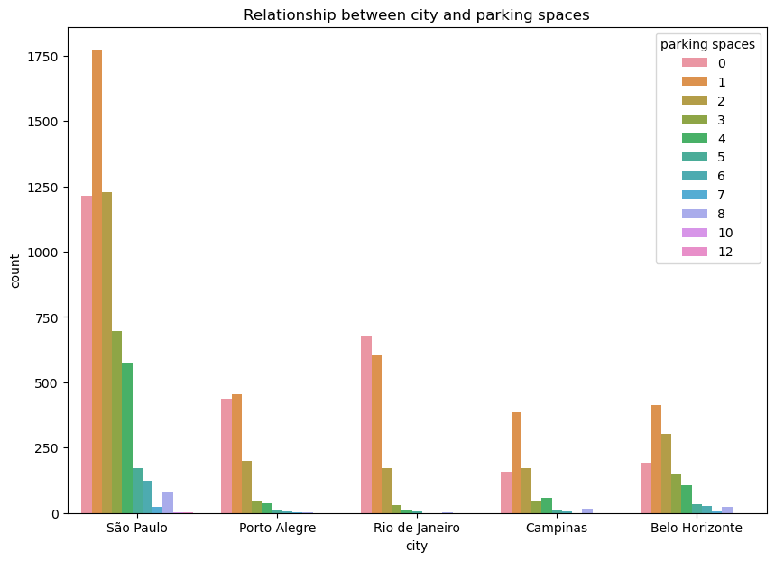
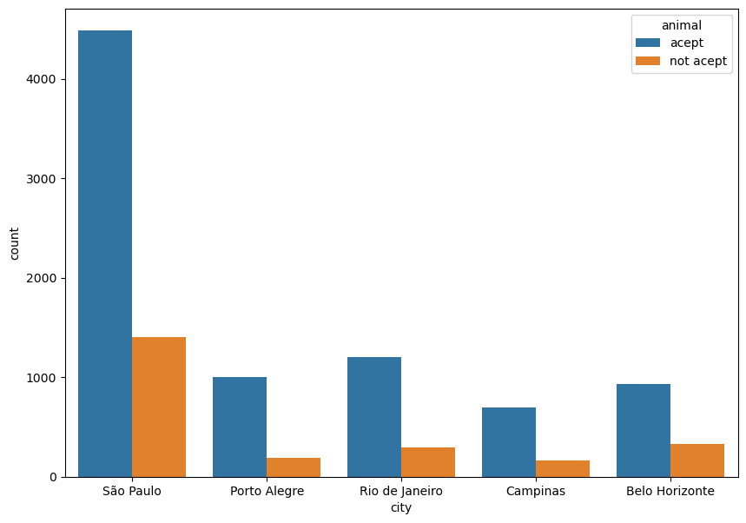
Relationship between city and parking spaces
Relationship between cities and animal
Interpretation:
Porto Alegere has more number of 0 and 1 parking spaces and Belo Horizonte city have houses that have more than 1 parking spaces .
Interpretation:
Belo Horizonte city don’t have houses that have pet acceptance while Porto Alegre city have more number of house for rent which accepts pets.

Slide 12
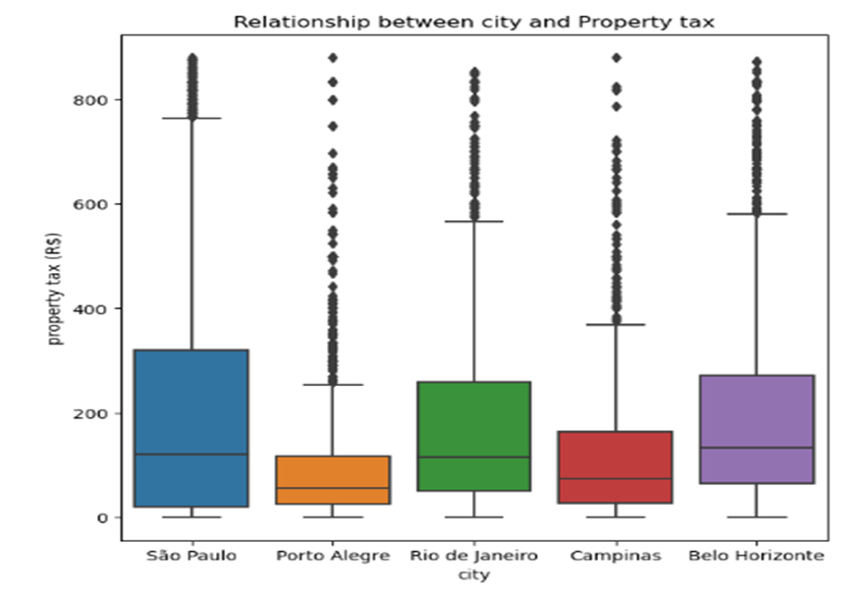
Relationship between City and property tax
Interpretation:
By above graph we can conclude that property tax is less in Porto Alegre city and moderate in Campinas city.

Slide 13
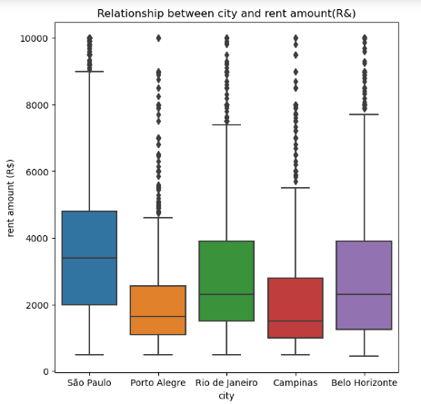
Relationship between city and rent amount
Interpretation:
Rent amount is less in Porto Alegre city and is moderate in Porto Alegre and Campinas city.

Slide 14
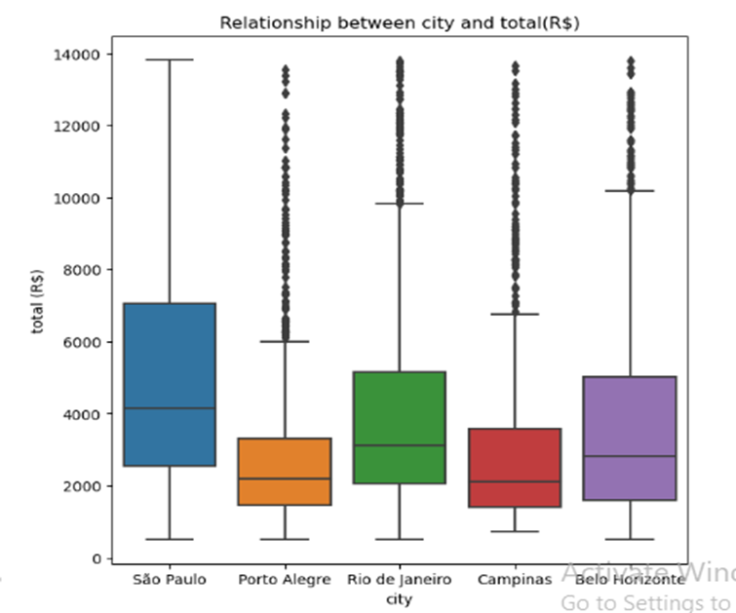
Relationship between City and total (R$)
Interpretation:
Total (Rs) rent for properties is less in Porto Alegre city and moderate in Porto Alegre and Campinas city

Slide 15
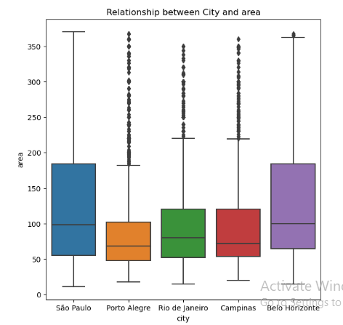
Relationship between city and area
Interpretation:
Porto Alegre have houses which have less area and Campinas and Belo Horizonte city have houses which have large area.

Slide 16
Conclusion
By the overall analysis we can conclude that Porto Alegre city will be suitable for bachelor to relocate because these cities provide houses that have one room , low rent, unfurnished houses, no property tax which would be suitable for bachelours.
Campinas city would be suitable for midsized family because these cities have houses that have more than 2 rooms, 2 or more parking space, acceptance of pets, moderate rent and property tax , furnished houses which would be suitable for mid sized family .
Belo Horizonte city and Campinas would be suitable for larged sized family because these cities have houses that have more than 2 rooms, 2 or more parking space, acceptance of pets, moderate rent and property tax ,large area, furnished houses which would be suitable for large sized family.

Slide 17
ThankYou

